Slide 1
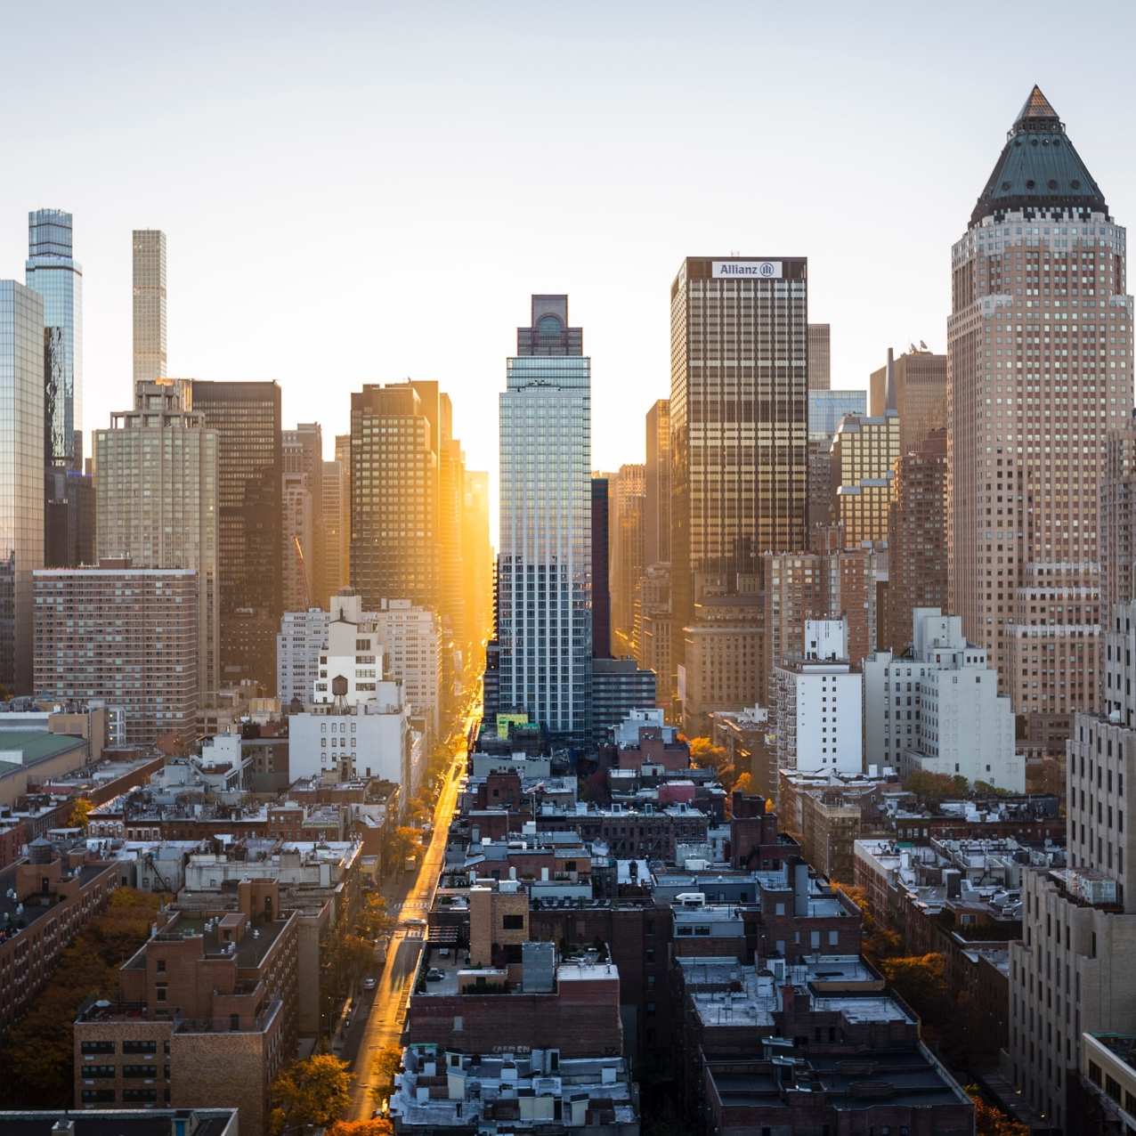
Parking citations in los Angeles
Aracely, kelli, and vinay
2019.04.03

Slide 2
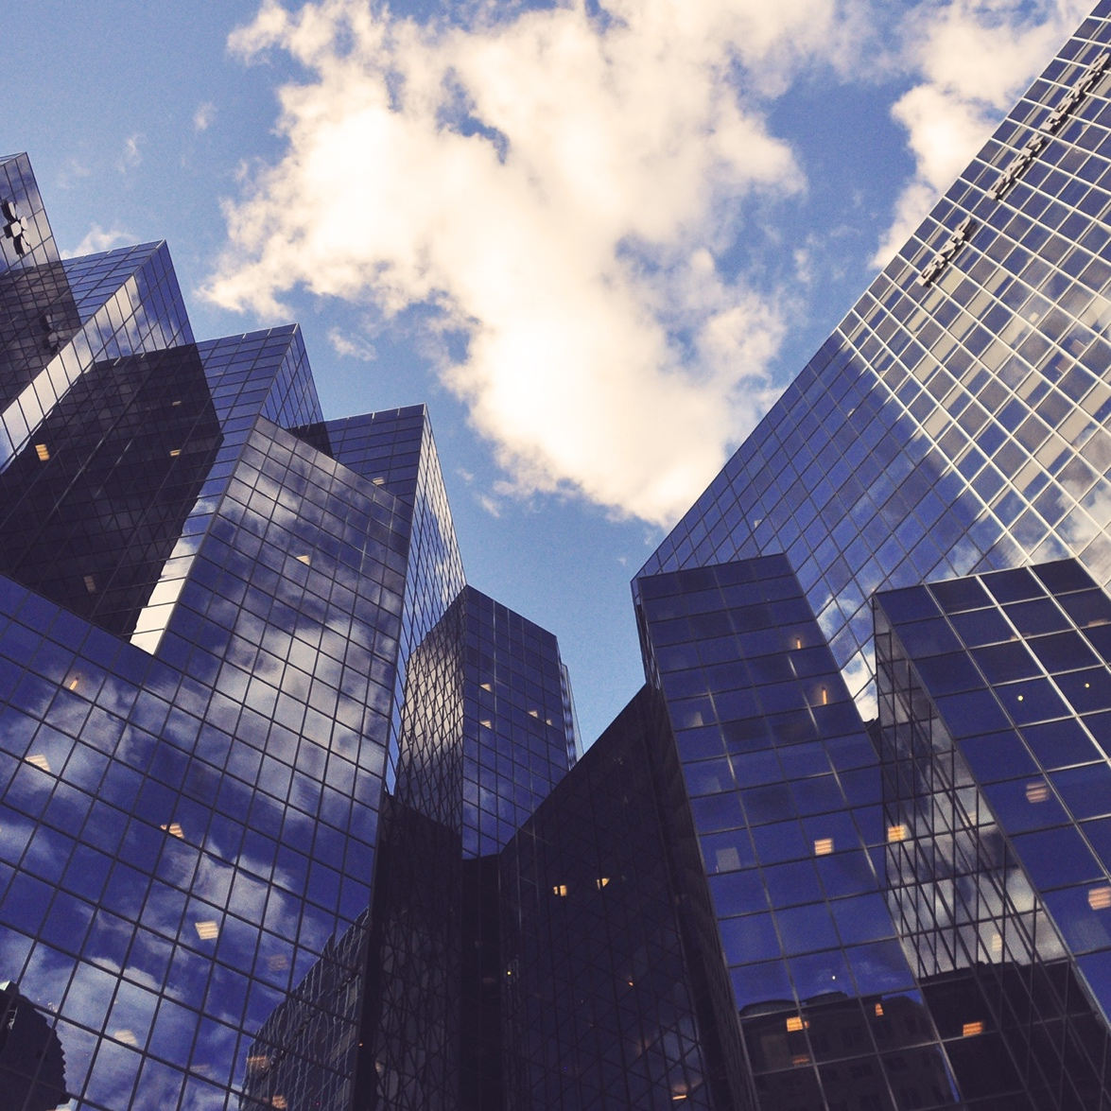
What are we trying to answer?
Timing
In 2018, what month was someone most likely to get a ticket in LA (of any type)?
Financial impact
Which violation types generated the most revenue?
What time of day was someone most likely to get a ticket (of any type)?

Slide 3
Meet the data: A log of parking citations in LA (2018)
Latitude
Ticket Number
Issue Date
Fine amount
Issue Time
Longitude
Many data points available:
Meter ID
Violation Code
Violation Description
Car Make
Route
Plate Expiration

Slide 4
Meet the data: A log of parking citations in LA (2018)
Ticket Number
Issue Date
Fine amount
Issue Time
Violation Code
Violation Description
Tailored data points to meaningful metrics

Slide 5
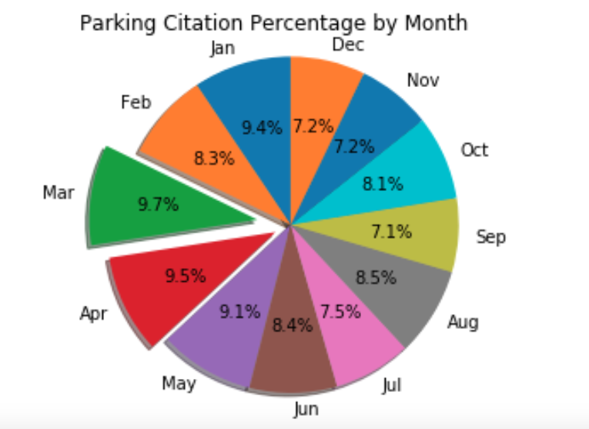
Analysis and Charts: Timing – view by month (2018)
Based on total parking citations in 2018, March had the largest number of citations

Slide 6
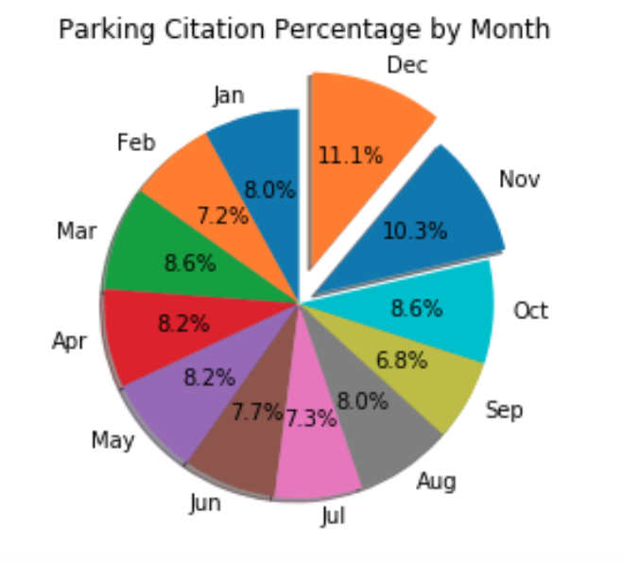
Analysis and Charts: Timing – view by month (Multiple years)
Based on total parking citations 2016-2018, December had the largest number of citations
Possible explanations : December coincides with the Christmas holiday which means
We would need to have more information on other variables such as
Time of day
Spread of violations by geography
Daily or monthly in-/out-migration of the city
Greater tourism
Decreased availability of parking, etc.

Slide 7
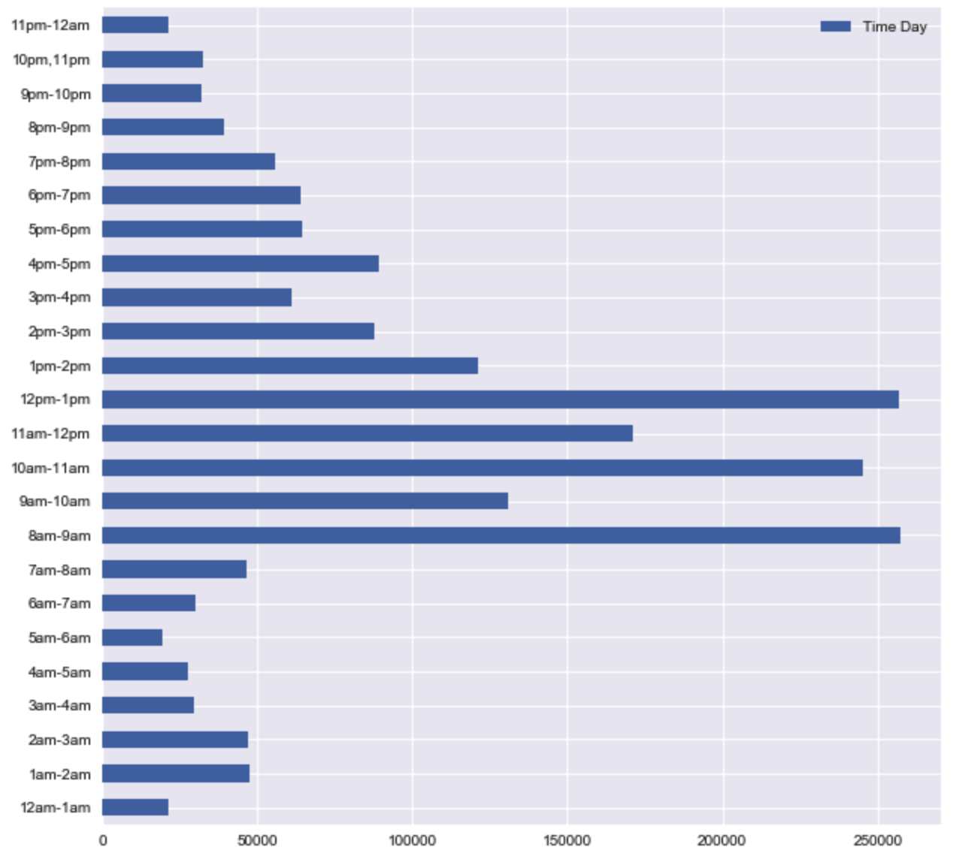
Analysis and Charts: Timing – view by HOUR OF DAY
Based on total parking citations in 2018, 8-9am followed by 12-1pm are the most active times for parking citations
Possible explanations :
We would need to have more information on other variables such as:
Composition of the violations by hour
Spread of violations by geography
Estimations on in-transit population based on hour
8-9am: Most likely the hour with the largest in-transit population (i.e. when most people are going to work)
12-1pm: Most likely the hour with large in-transit population (i.e. people are going to lunch, moving from one event to another)

Slide 8
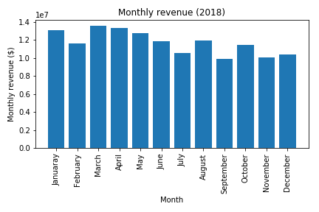
Analysis and Charts: FINANCIAL IMPACT
In 2018, March was the largest revenue-generating month from parking citations
Interesting observations:
Comparing the first 6 months to the last 6 months, more revenue was generated during the first half of the year than the second
Previous finding showed December had the largest number of violations, but March is when the most revenue is generated

Slide 9
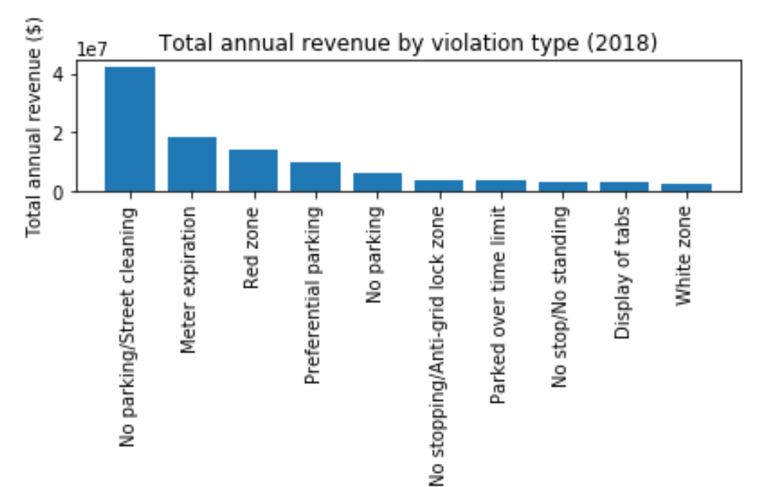
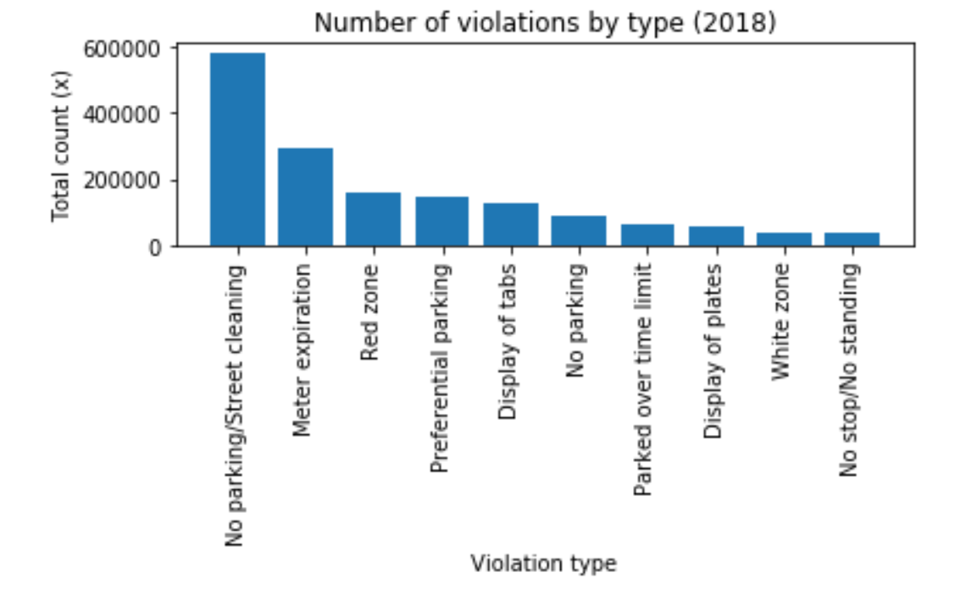
Analysis and Charts: FINANCIAL IMPACT
Notes:
We analyzed no. of violations by type (left-hand side) versus total annual revenue by violation type (right-hand side)
As one would expect, they are virtually the same. However, the interesting part is in the differences…
Obvious observations: The most voluminous citation is the most profitable: No parking/street cleaning was the most common offense in addition to the largest revenue generating citation; it clearly exceeds other citations in volume at almost twice the size of the second-largest offense
What can we conclude comparing these side-by-side?

Slide 10


Problems & solutions
Timing
Deep dive into composition of violation type
Financial impact
Geography
Visualization tools to illustrate concentration of parking citations
Superimpose findings on national holidays, by neighborhood, proximity to parking structures and associated fees
other CONSIDERATIONS
Timing
Given the total violations by hour, what is the composition of those violations?
Financial impact
What are the key drivers behind the trends of the largest parking citations – reviewing other factors
Geography
Where is someone more likely to get a ticket in the city?
E.g. availability of parking, parking rates in a certain geographic area, residential/commercial/tourist area, holiday on/off season
solutions

Slide 11
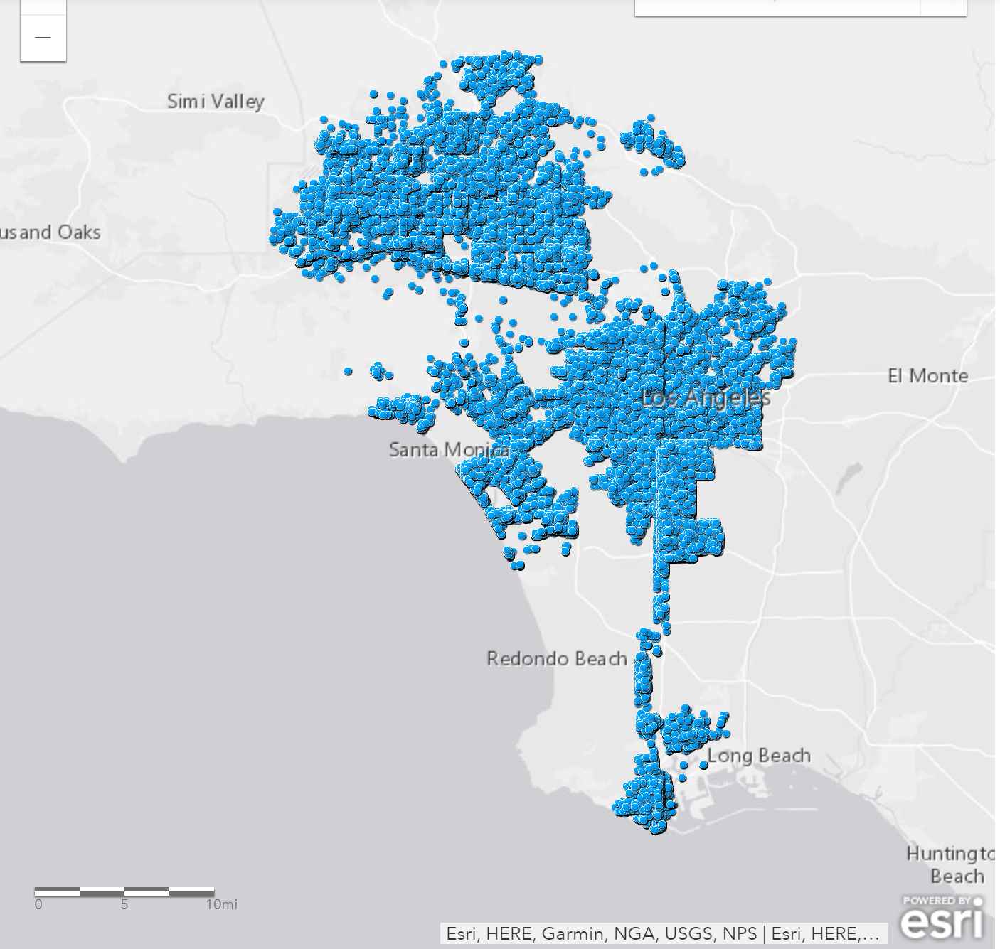


conclusIONS & FUTURE DIRECTIONS
CONCLUSIONS
How future deep dive of the data could be useful:
Most likely to receive a parking citation: 8-9am followed by 12-1pm
Most common citations: No parking/street sweeping and meter expiration
Top revenue-generating violations: No parking/street sweeping and meter expiration
City planning
Incentive structures (positive or negative) to reduce carbon emissions
Availability of parking spaces
More efficient use of space for parking
Location of parking spaces
Notes:
During lunch hours (12-1pm) and typical work hours (8-9am) was the most likely time to receive a parking citation (irrespective of other factors i.e. location, availability of parking spaces, etc.)
Parking citation on a total basis suggests that no parking/street sweeping and meter expiration are the most common violations

Slide 12

Thank you
https://github.com/aracelymndz/Project_1.git

